Slide 1
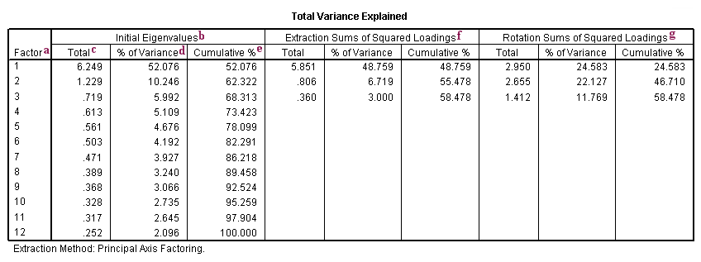
Example01

Slide 2
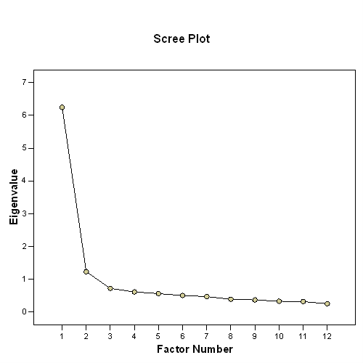

Slide 3
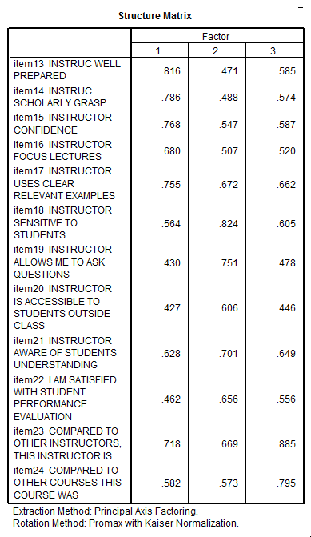

Slide 4
Example02: The SAQ (SPSS Anxiety Questionnaire)
Hypothetical example of the survey which Andy Field terms the SPSS Anxiety Questionnaire. The SAQ-8 consists of the following questions:
Statistics makes me cry
My friends will think I’m stupid for not being able to cope with SPSS
Standard deviations excite me
I dream that Pearson is attacking me with correlation coefficients
I don’t understand statistics
I have little experience of computers
All computers hate me
I have never been good at mathematics

Slide 5
Component Matrixª
Item | Component
 | 1 | 2 | 3 | 4 | 5 | 6 | 7 | 8
1 | 0.659 | 0.136 | -0.398 | 0.160 | -0.064 | 0.568 | -0.177 | 0.068
2 | -0.300 | 0.866 | -0.025 | 0.092 | -0.290 | -0.170 | -0.193 | -0.001
3 | -0.653 | 0.409 | 0.081 | 0.064 | 0.410 | 0.254 | 0.378 | 0.142
4 | 0.720 | 0.119 | -0.192 | 0.064 | -0.288 | -0.089 | 0.563 | -0.137
5 | 0.650 | 0.096 | -0.215 | 0.460 | 0.443 | -0.326 | -0.092 | -0.010
6 | 0.572 | 0.185 | 0.675 | 0.031 | 0.107 | 0.176 | -0.058 | -0.369
7 | 0.718 | 0.044 | 0.453 | -0.006 | -0.090 | -0.051 | 0.025 | 0.516
8 | 0.568 | 0.267 | -0.221 | -0.694 | 0.258 | -0.084 | -0.043 | -0.012
Extraction Method: Principal Component Analysis.
a. 8 components extracted.

Slide 6
Total Variance Explained
Component | Initial Eigenvalues |  |  | Extraction Sums of Squared Loadings
 | Total | % of Variance | Cumulative % | Total | % of Variance | Cumulative %
1 | 3.057 | 38.206 | 38.206 | 3.057 | 38.206 | 38.206
2 | 1.067 | 13.336 | 51.543 | 1.067 | 13.336 | 51.543
3 | 0.958 | 11.980 | 63.523 | 0.958 | 11.980 | 63.523
4 | 0.736 | 9.205 | 72.728 | 0.736 | 9.205 | 72.728
5 | 0.622 | 7.770 | 80.498 | 0.622 | 7.770 | 80.498
6 | 0.571 | 7.135 | 87.632 | 0.571 | 7.135 | 87.632
7 | 0.543 | 6.788 | 94.420 | 0.543 | 6.788 | 94.420
8 | 0.446 | 5.580 | 100.000 | 0.446 | 5.580 | 100.000
Extraction Method: Principal Component Analysis.

Slide 7
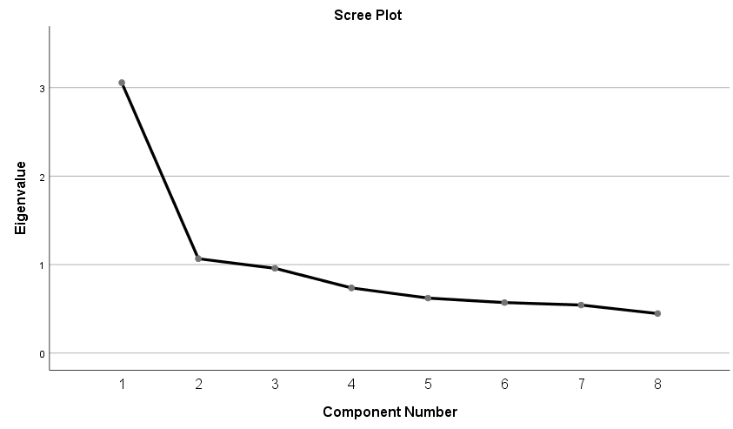

Slide 8
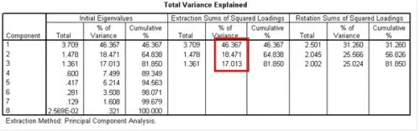
Example 03

Slide 9
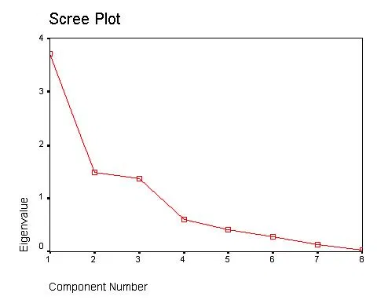

Slide 10
